Slide 1
The Math of Guitar
Ryan Y. Batubara

Slide 2
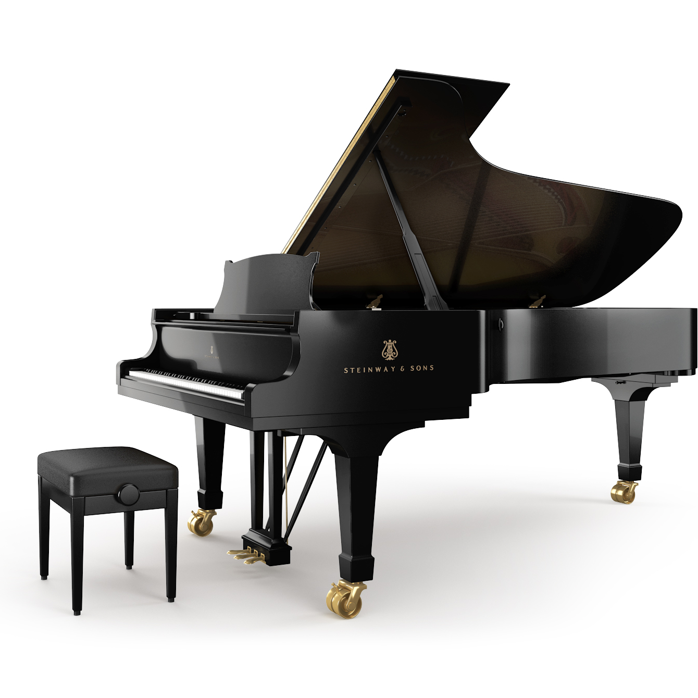
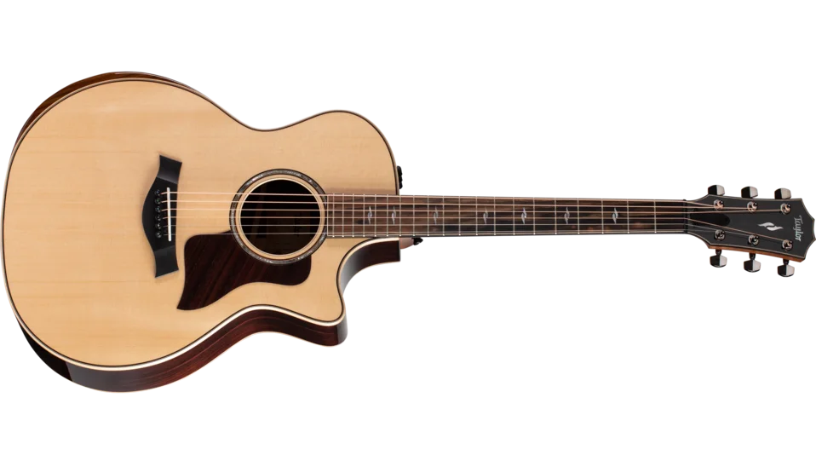
Icebreaker
Which can produce a note of higher frequency, this guitar or piano?

Slide 3
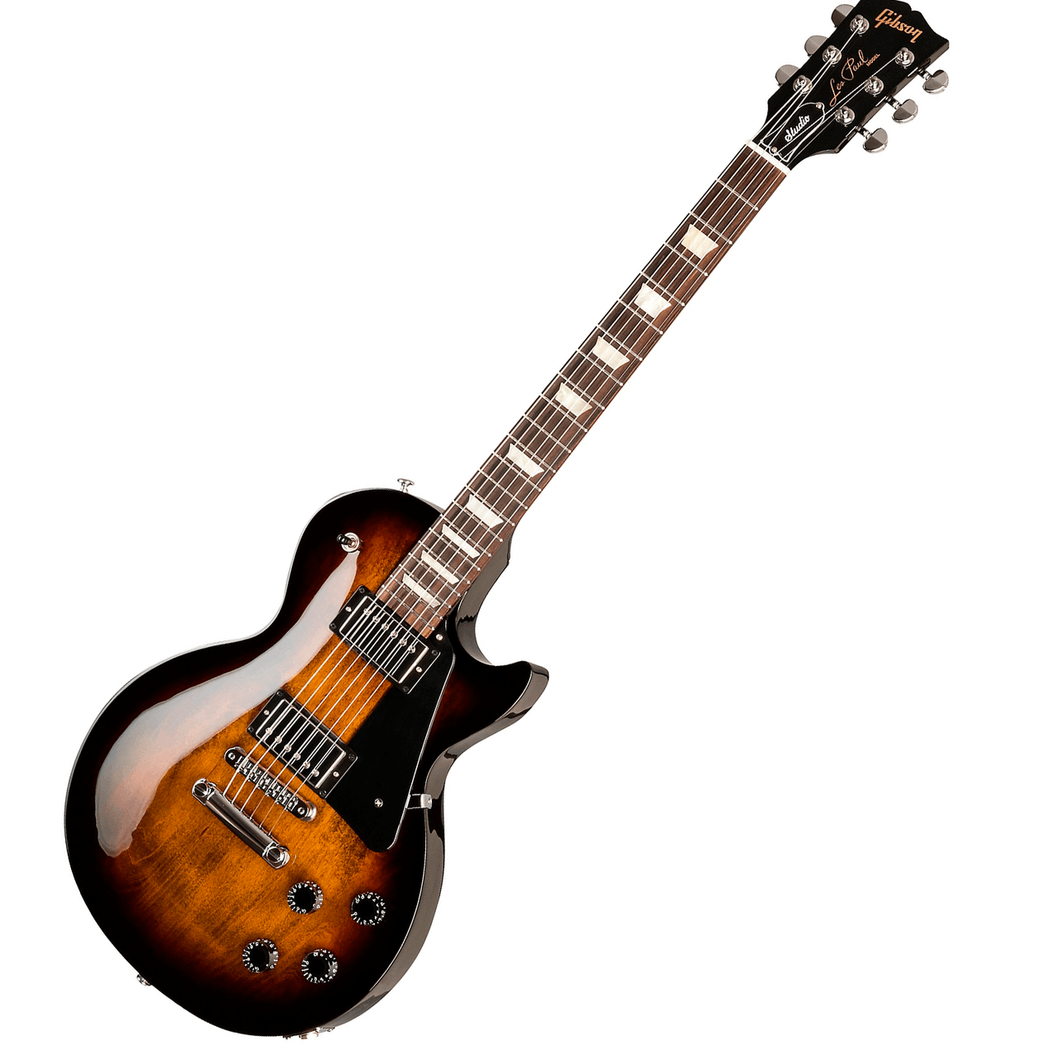
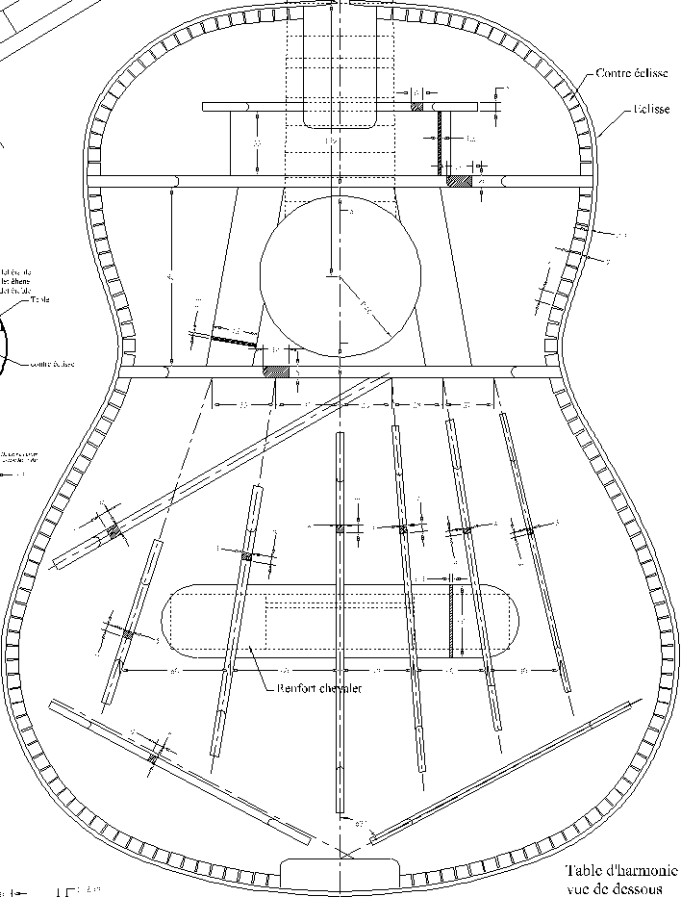
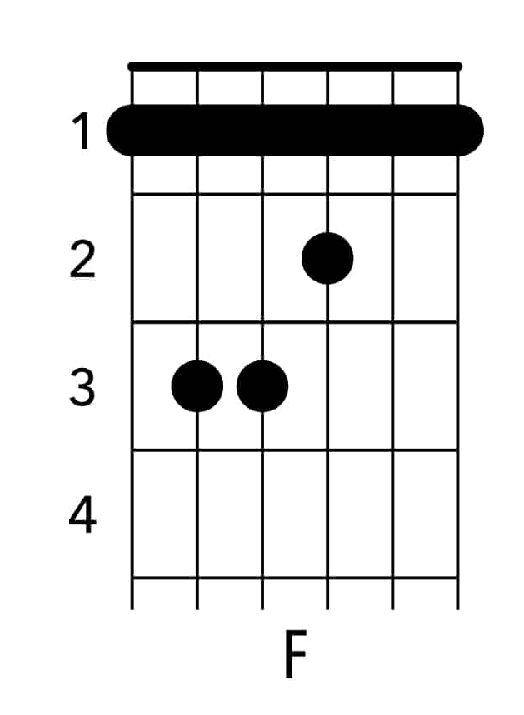
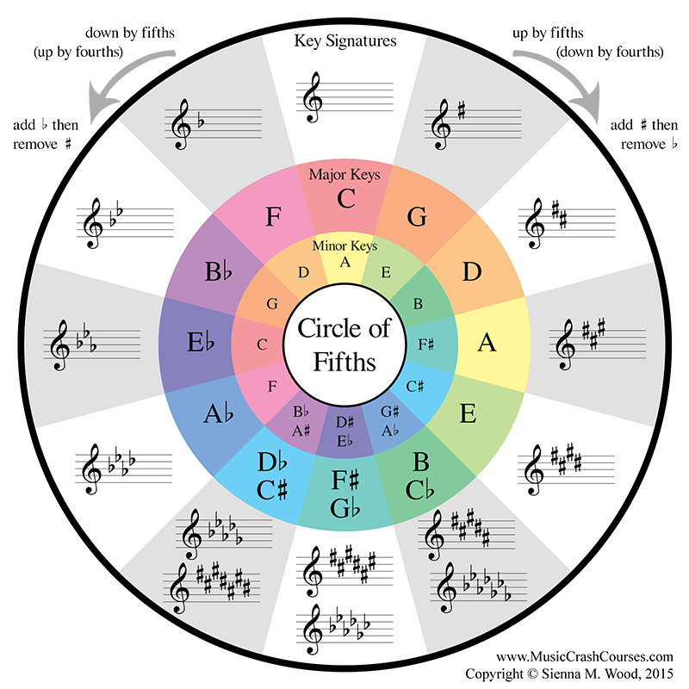
What this talk is NOT about

Slide 4

What this talk is about
f_{D0} ⋅ r = f_{C0}
f = — —
MATHEMATICS
1
T
2L
μ

Slide 5
Models of Sound

Slide 6
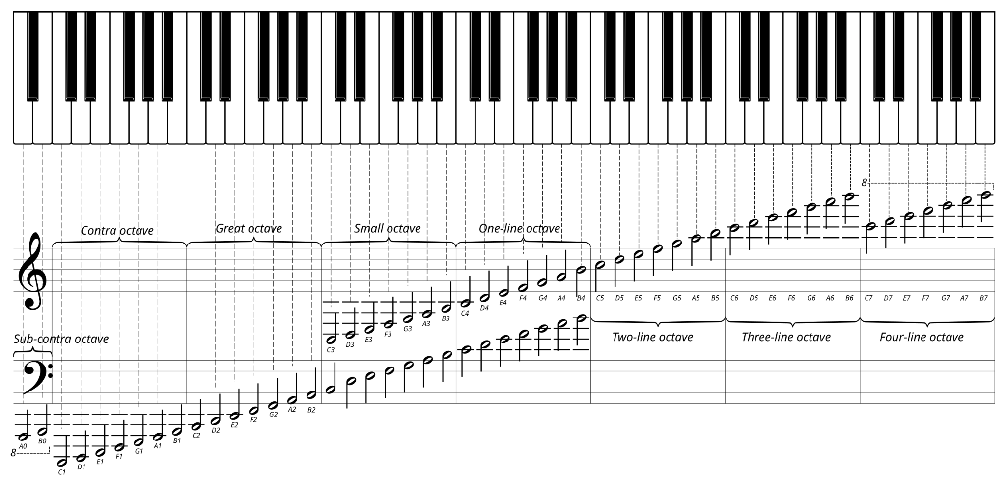
The 12-tone system
There are 12 notes:
C C# D D# E F F# G G# A A# B
Each note is given an octave. Here is C4 up to B4:

Slide 7

The 12-tone system
There are 12 notes:
C C# D D# E F F# G G# A A# B
fret 0
fret 12
E
F
F#
G
G#
A
C
C#
D
F
G#
A
B
A#
B
D#
C
E
F#
A#
G

Slide 8
The 6 strings
The first, top string has notes E4 … C5.
The sixth, bottom string has notes E2 … C3.
Why the difference?
E4
C5
E2
C3

Slide 9
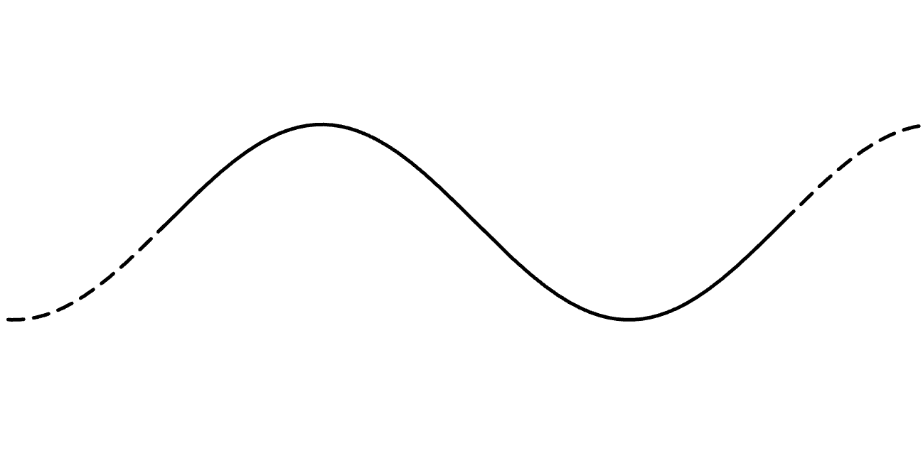
The transverse wave
crest
amplitude
trough
1 cycle

Slide 10
v = fλ
speed = frequency × wavelength
m/s
cycles/s
m/cycle
wavelength = width of 1 cycle

Slide 11
The string frequency formula
tension (kgm/s² or N)
f = — —
1
T
frequency (cycles/s or Hz)
2L
μ
mass / length (kg/m)
length (m)

Slide 12
Why this formula?
f = — —
1
T
2L
μ
v = fλ (rearranged)
f = — · v
1
λ

Slide 13
Why this formula?
L
f = — —
1
T
λ
2L
μ
f = — · v
1
λ

Slide 14
Why this formula?
v ∝ —
L
T
μ
f = — —
1
T
(kgms⁻²)ª
2L
μ
ms⁻¹ = ———
λ
(kgm⁻¹)^{b}
f = — · v
1
⇒ a = 1/2, b = -1/2
λ

Slide 15
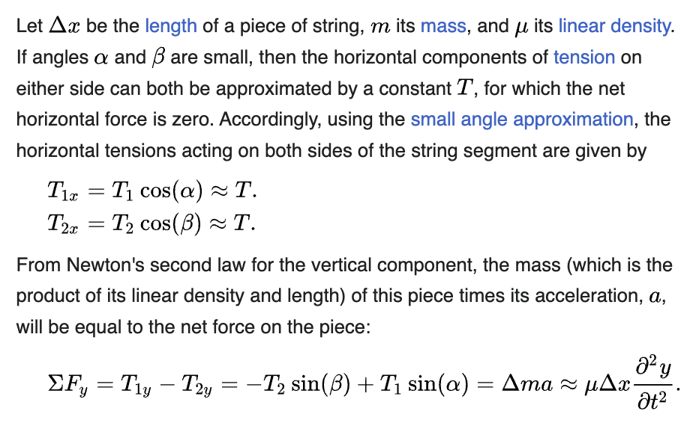
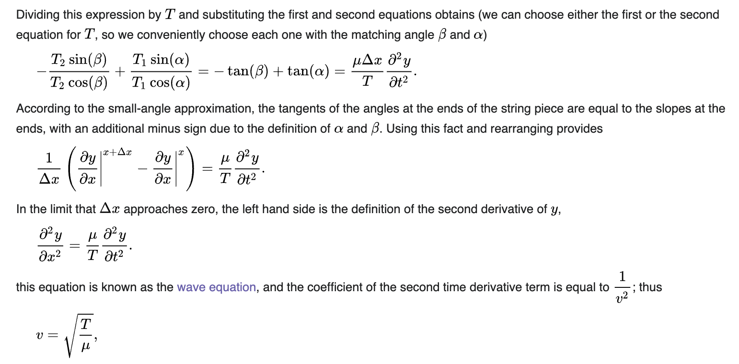
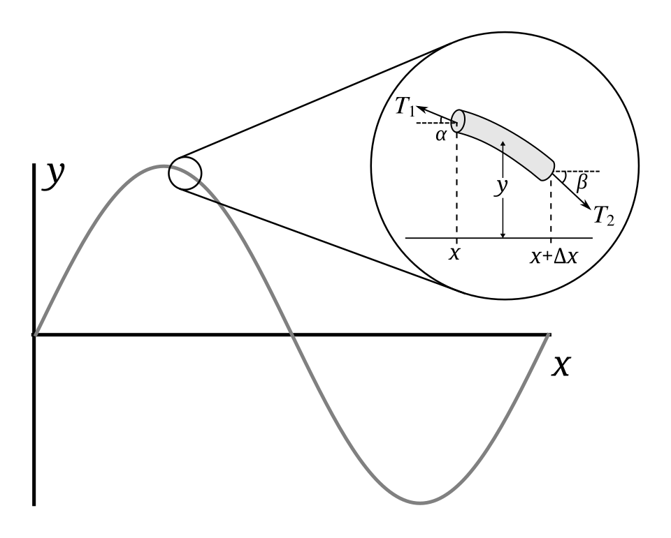
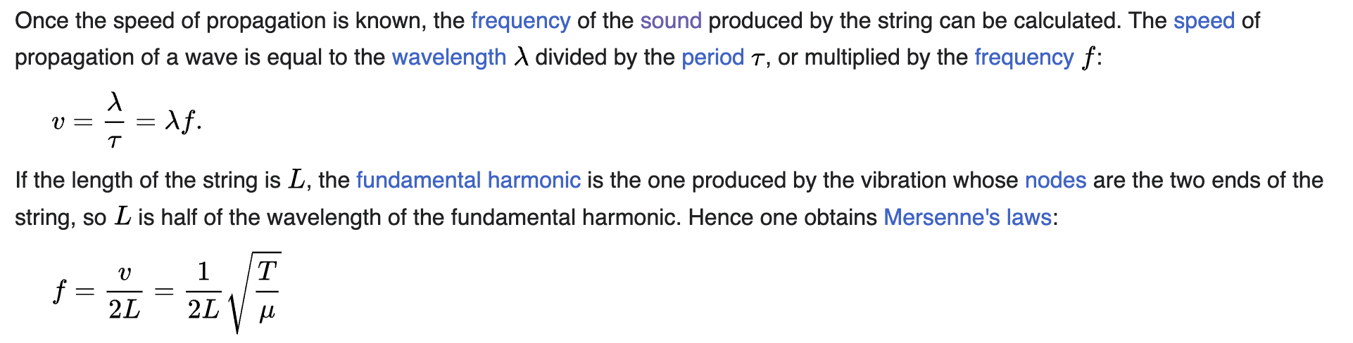
The formal derivation

Slide 16
Back to the 6 strings
Why do different strings produce different notes?
A: Different tension and mass.
f = — —
1
T
2L
μ
E4
C5
E2
C3

Slide 17
Back to the 6 strings
Why do different strings produce different notes?
A: Different tension and mass.
What determines note frequencies?
E4
C5
E2
C3

Slide 18
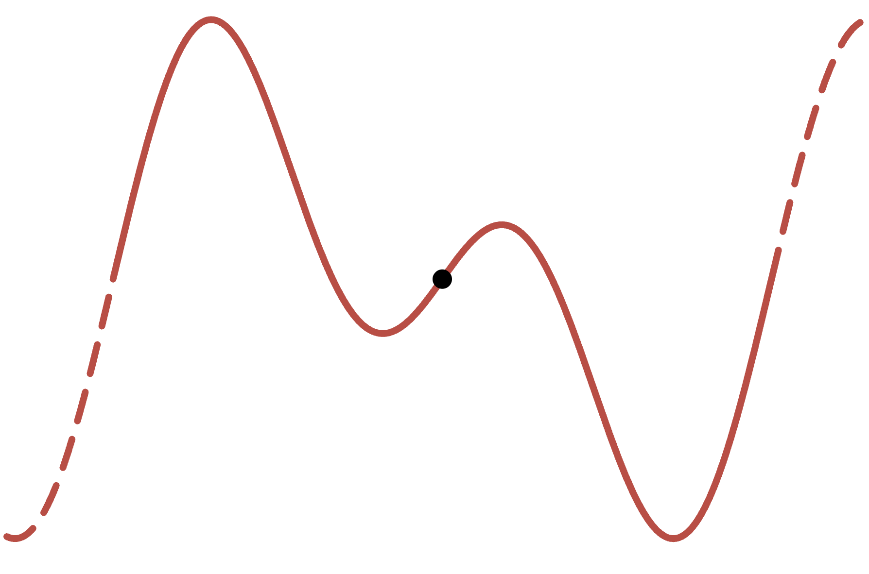
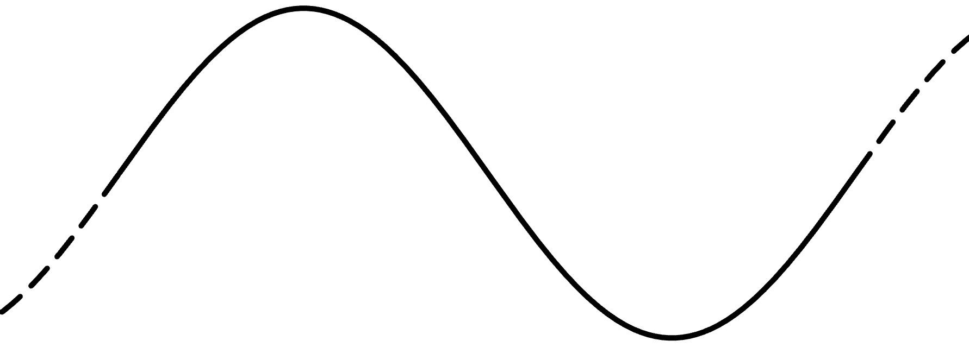
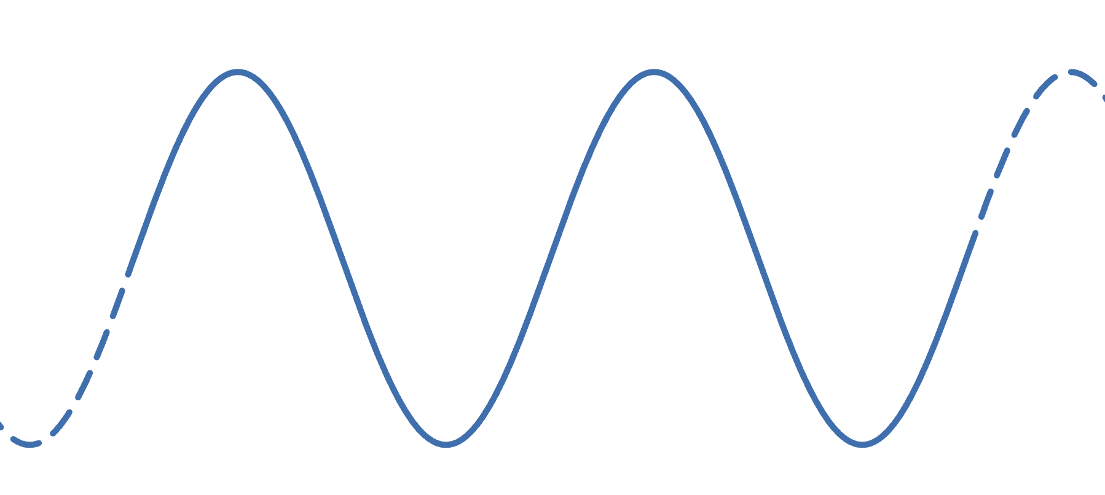
Back to notes
Each note and octave is just a certain frequency.
… B3 C4 C#4 … B4 C5 C#5 …
… f_{B3} f_{C4} f_{C#4} … f_{B4} f_{C5} f_{C#5} …
only integers make this a point of rotational symmetry
Fact: Octaves should be integer multiples of another:
+
=
f_{C4}
f_{C5}=2f_{C4}

Slide 19
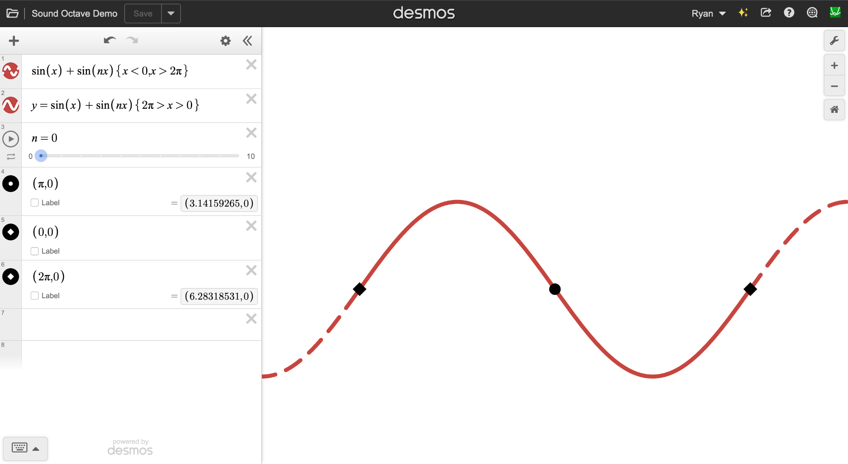
Octaves demo

Slide 20
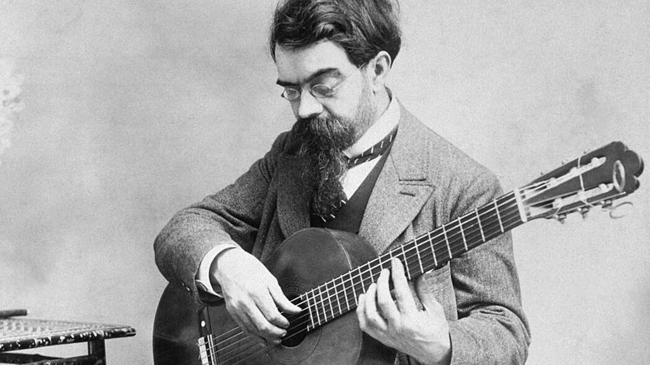

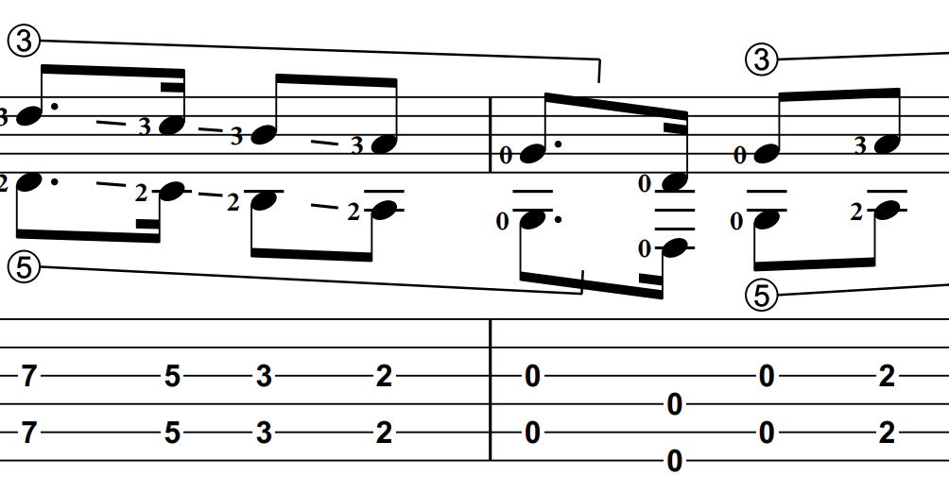
ex: octave intervals
“Tango” (Francisco Tárrega)
DGDGBE

Slide 21
Octaves on the fretboard
Recall:
f = — —
1
T
2L
μ
Thus halving string length brings us up an octave!
fret 0
fret 12
E4
E5
L/2
L/2

Slide 22
Other notes
What about other notes? For all notes n from C, C#, …, we want
— = — = …
n1
n2
n0
n1
→ Halving string length always brings us up an octave.
fret 1
fret 13
F4
F5
L’/2
L’/2

Slide 23
Fretboard design
So why aren’t frets equidistant?
| | | | | | | | | | | |
Why do higher frets get closer together?

Slide 24
Equal temperament
All notes should be equally distant. Suppose:
f_{D0} + c = f_{C0}
f_{D#1} + c = f_{D0}
…
But we want
— = ———
=
C1
— = ———
C0 + 12c
C2
C0 + 24c
C0
C0
C1
C0 + 12c

Slide 25
Equal temperament
All notes should be equally distant. Suppose:
f_{D0} ⋅ r = f_{C0}
f_{D#1} ⋅ r = f_{D0}
…
Now we have
— = ———
=
C1
— = ———
C0 ⋅ r¹²
C2
C0 ⋅ r²⁴
C0
C0
C1
C0 ⋅ r¹²

Slide 26
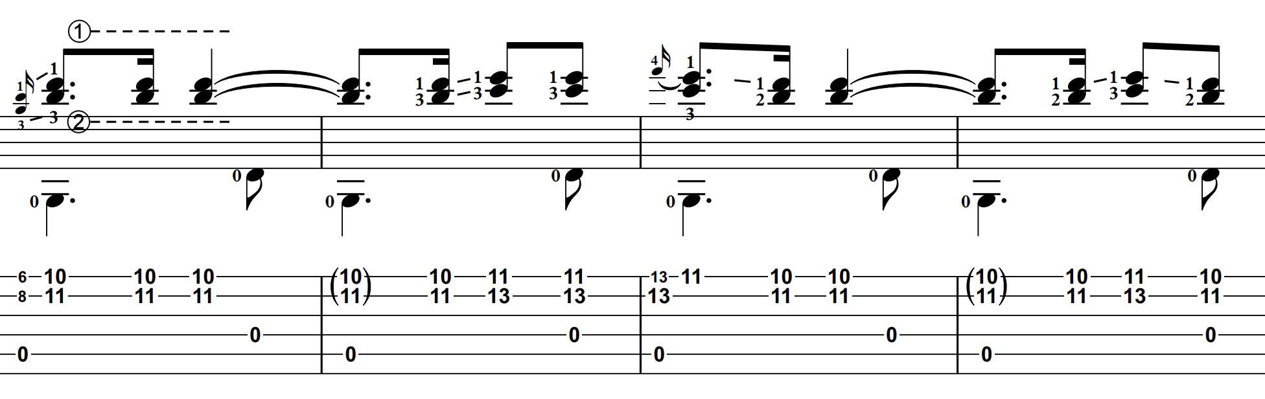
ex: other intervals
“Tango” (Francisco Tárrega)
DGDGBE

Slide 27
Why uneven frets?
Since f_{C1} = 2 ⋅ f_{C0} = r¹² ⋅ f_{C0} we have
r = 2^{1/12}
Recall L ∝ 1 / f . So the nth note has L_{n} ∝ 2^{-n/12}.

Slide 28
Back to the 6 strings
Why do different strings produce different notes?
A: Different tension and mass.
What determines note frequencies?
A: Equal temperament; this makes frets uneven.
E4
C5
E2
C3

Slide 29
Recall: icebreaker
Which can produce a note of higher frequency, this guitar or piano?
Guitar : highest string, highest fret is C5
Piano : highest note is C8

Slide 30
2. Harmonics

Slide 31
The longitudinal wave
compression
string
diameter
1 cycle
expansion

Slide 32
The harmonics
f = — —
1
T
2L
μ
1
f₁
fundamental
12
2
f₂ = 2 f₁
1 octave
7
19
3
f₃ = 2⋅3/2 f₁ ≈ 2⋅2^{4/12}
1 oct. + 3rd
5
12
24
4
f₄ = 2⋅2 f₁
2 octaves
4
9
16
27
5
f₅ = 4⋅5/4 f₁ ≈ 2⋅2^{7/12}
2 oct. + 5th

Slide 33
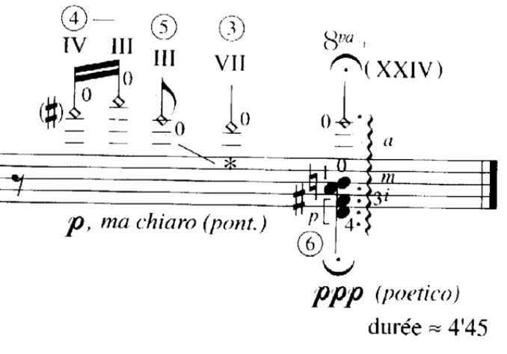
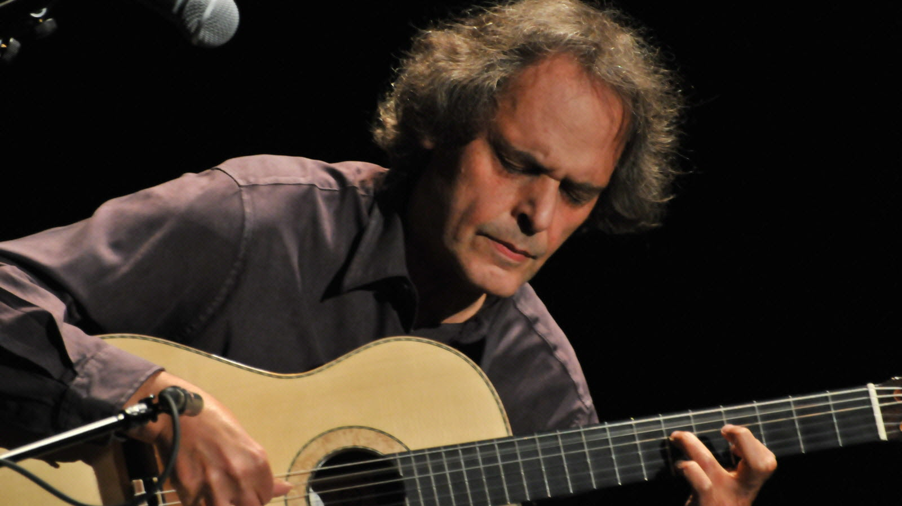
ex: harmonics for reach
“Valse de Loges” (Roland Dyens)
EADGBE

Slide 34
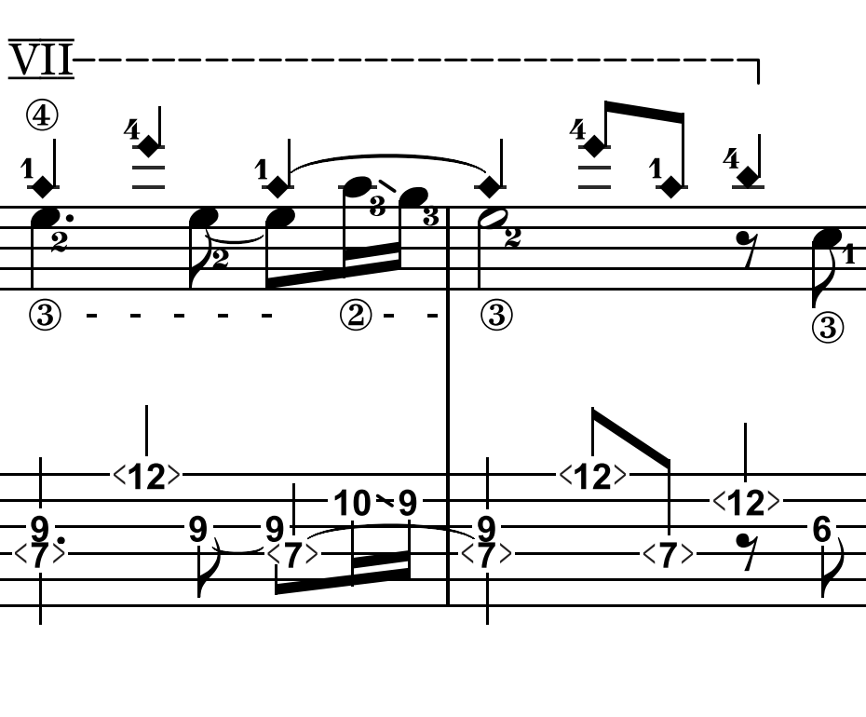
ex: harmonic melody
“Safe Haven” (Sönke Meinen)
DADGBE

Slide 35
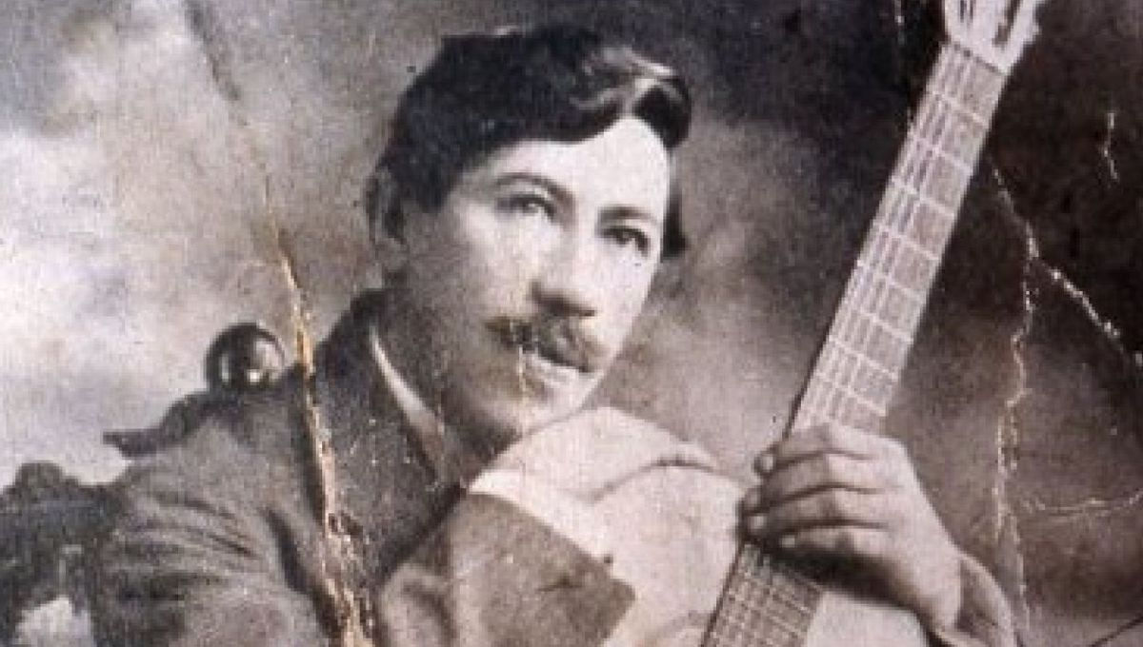
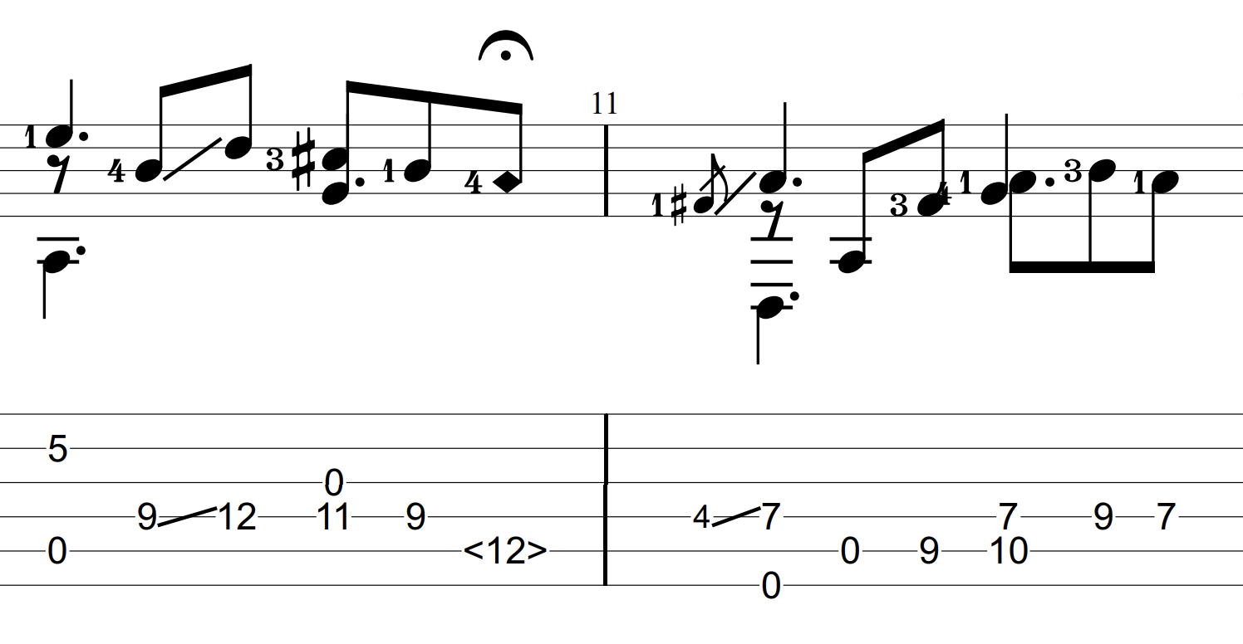
ex: harmonics for sustain
“Julia Florida” (Agustín Barrios Mangoré)
DADGBE

Slide 36
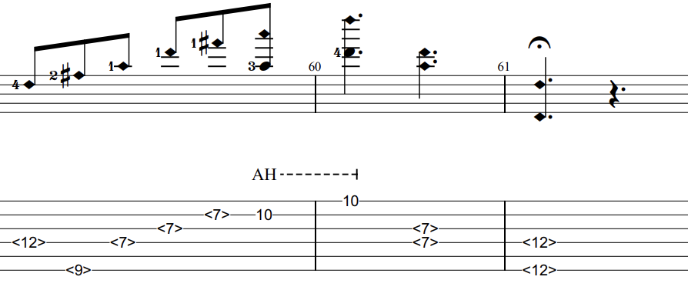
ex: harmonics for scales
“Julia Florida” (Agustín Barrios Mangoré)
DADGBE

Slide 37

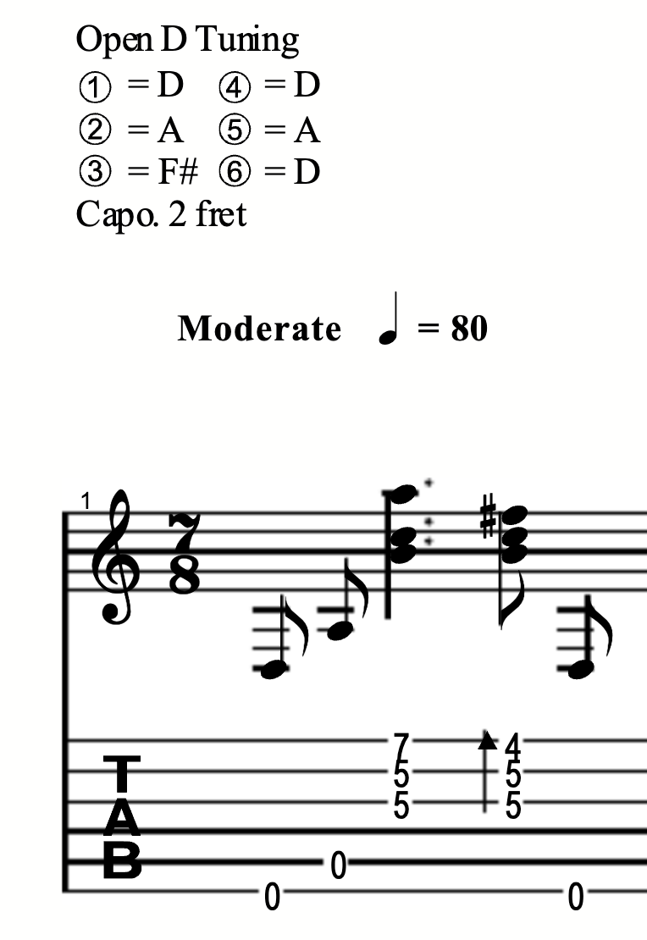
ex: harmonics for volume
“Sunset on the Peak” (Masaaki Kishibe 岸部真明)
DADF#AD

Slide 38
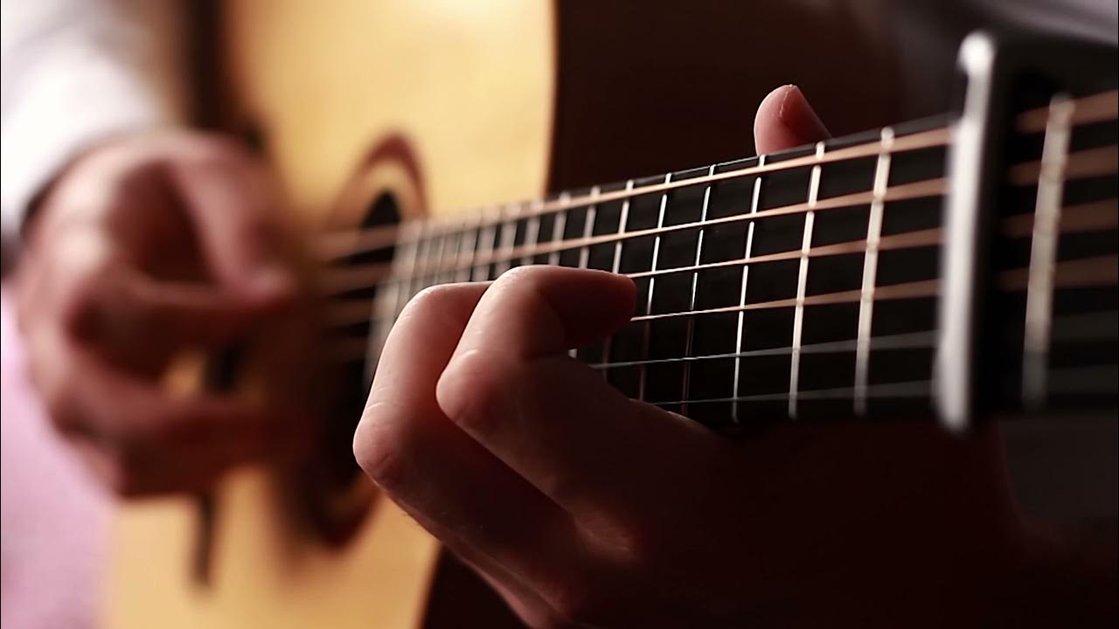
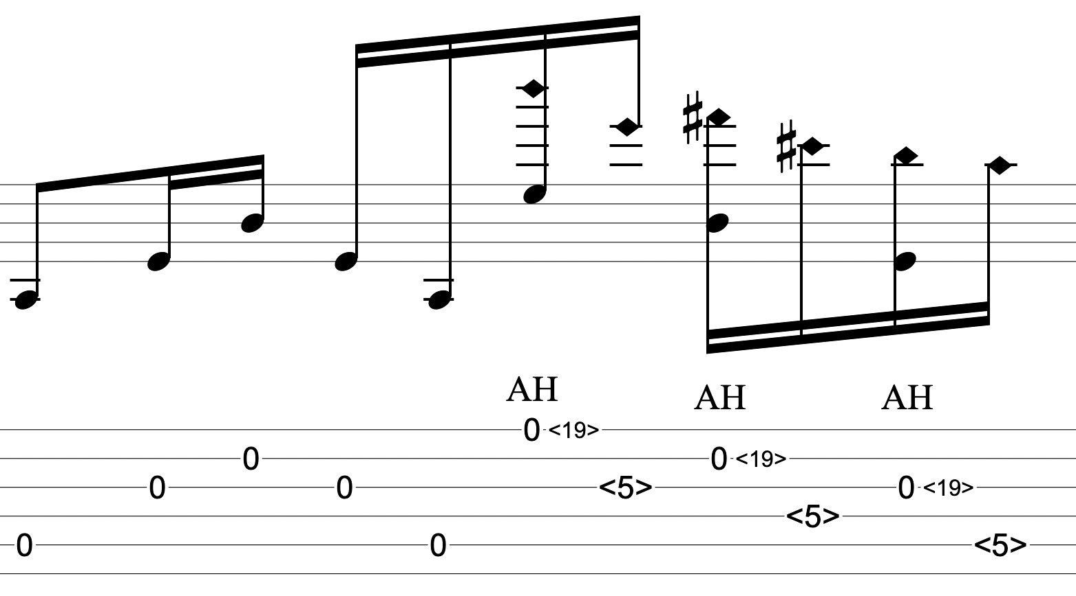
ex: everything combined
“Bell’s Harmonics” (Alan Gogoll)
EAC#EBE

Slide 39
Recall: icebreaker
Which can produce a note of higher frequency, this guitar or piano?
Guitar : highest string, fret, & harmonic is C7 Piano : highest note is C8

Slide 40
Closing question
Which can produce a note of lower frequency, this guitar or piano?
Guitar : ??? Piano : A0 (typical 88 key)

